Slide 1



AIR AWARE
Smart Air Quality Prediction System
Team Members
K. Likitha
S.Sneha
Sahil
Raunit Singh
Faariha

Slide 2

PROBLEM STATEMENT
Air pollution levels are increasing rapidly.
People are unaware of current AQI and health impacts.
Existing platforms are complex and not user-friendly.
PROPOSED SOLUTION
AirAware provides a simple, clean web dashboard
Shows real-time AQI values
Uses Machine Learning for AQI prediction
Offers health advice and reports
01

Slide 3
PROBLEM STATEMENT
Air pollution is increasing across major cities, affecting health and daily decisions.
People lack simple tools to check potential air quality.
1.
2.
AirAware solves this by predicting AQI using ML and providing clear visual insights.
02

Slide 4
FEATURES
  Clean & user-friendly UI
  Real-time AQI values
  Machine Learning based AQI prediction
  AI-powered Chatbot (Air Quality Assistant)
  Health advisory suggestions
  Downloadable AQI reports (PDF)
  Dark & Light mode toggle
  User feedback system
  Responsive dashboard for all devices
03

Slide 5
FRONTEND OVERVIEW
  Frontend Technologies
  HTML5
  CSS3
  JavaScript
  Google Material Icons
  Chart.js (for graphs & visualizations)
  Purpose:
  Design clean UI
  Display AQI cards, charts & dashboard
  Improve user experience
04

Slide 6

BACKEND WORK
Backend Technologies
  Python
  Flask Framework
Backend Responsibilities
  Handle API requests
  Connect frontend with ML model
  Fetch real-time pollution data
  Generate AQI predictions
  Provide JSON responses to UI
05

Slide 7
DATABASE & MACHINE LEARNING
Database
  MySQL
  Stores:
    User login details
    Feedback data
    AQI records
Machine Learning
  Linear Regression model
  Used for AQI prediction
  Trained on historical AQI dataset
  Inputs: PM2.5, CO, NO₂
  Output: AQI value
06

Slide 8
SYSTEM ARCHITECTURE
Workflow
  User interacts with frontend dashboard
  Request sent to Flask backend
  Backend fetches real-time pollution data
  ML model predicts AQI
  Data sent back as JSON
  Charts & AQI cards update dynamically
  Reports can be downloaded as PDF
06

Slide 9
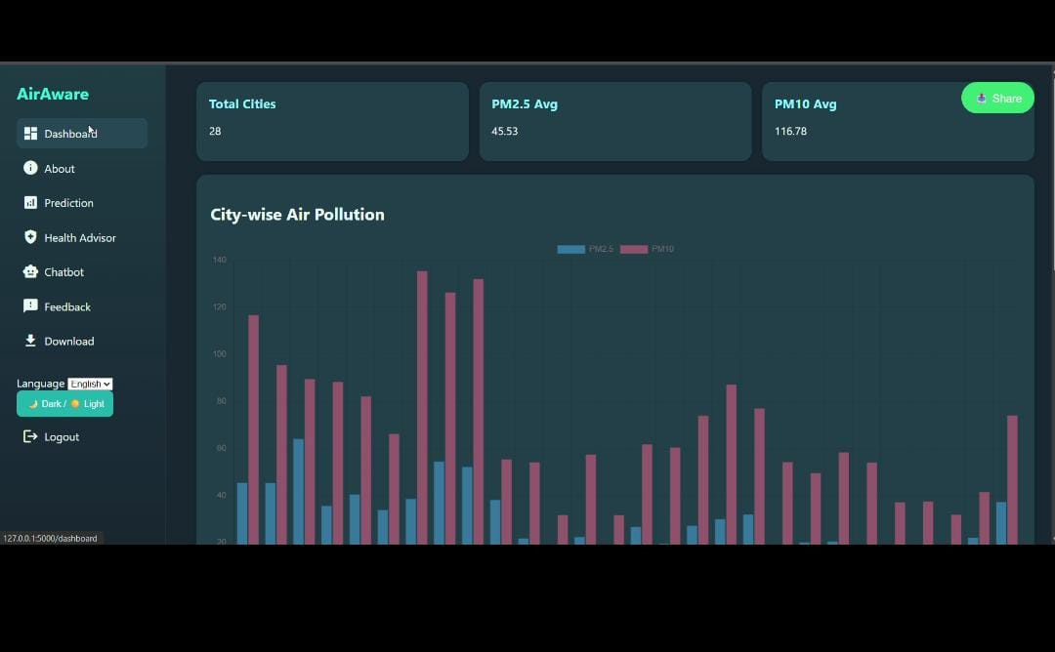
07

Slide 10
TEAM CONTRIBUTIONS
Team Member Contributions
  Sahil & Faariha:
    Complete backend development
    API handling & ML integration
  Likitha:
    Frontend UI design
    Dashboard layout & responsiveness
  Raunath Singh:
    MySQL database queries
    Basic ML model preparation
  Sneha:
    AI Chatbot integration
    Chatbot logic using GPT-4o mini
09

Slide 11
EXTRA FEATURES
  Session-based login system
  Dark / Light theme toggle
  Multi-language support (i18n using Flask session)
  CSV file import/export
  Download:
  All AQI data
  City-wise AQI data
  AI Chatbot using GPT-4o mini
  Fully responsive dashboard UI
09

Slide 12
CONCLUSION
  AirAware provides a smart and reliable AQI monitoring system
  Combines UI, ML, real-time data & AI chatbot
  Helps users understand air pollution easily
  Improves public awareness and health safety
09

Slide 13
THANK YOU
10

